Slide 1
Surface area of prisms
Perimeter, area and volume

Slide 2
how to use Oak lessons

Slide 3
I can find the surface area of 3D shapes in an efficient way.

Slide 4
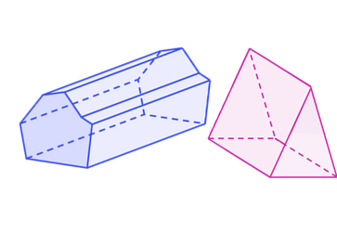
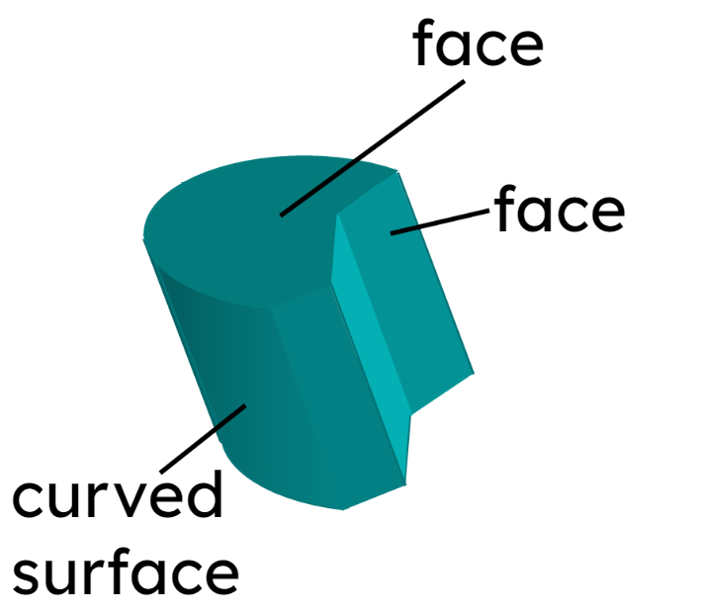
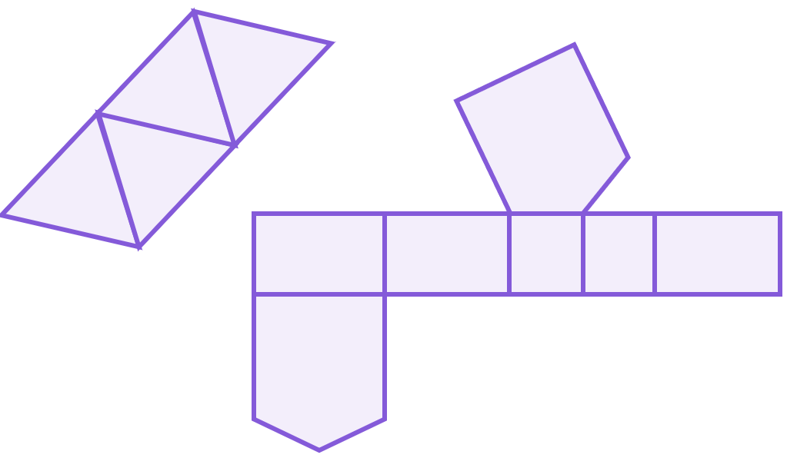
A prism is a polyhedron with a base that is a polygon and a parallel opposite face that is identical. The corresponding edges of the two polygons are joined by parallelograms.
Faces are the flat 2D surfaces of a 3D shape.
The net of a 3D object is a 2D representation of its faces that can be folded up into the 3D object.
The surface area is the total area of all the surfaces of a closed 3D shape. The surfaces include all faces and any curved surfaces.

Slide 5

Surface area of prisms
Nets of right prisms
Calculating the surface area of prisms
Being efficient in finding the surface area

Slide 6
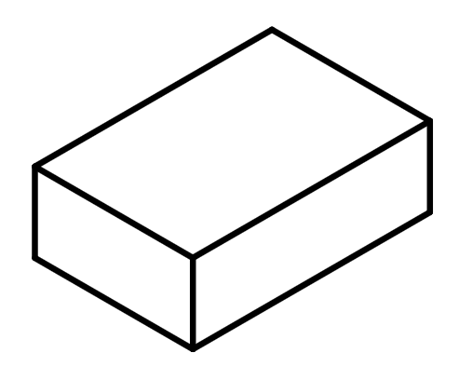
Nets of right prisms
A net can be folded to form a three-dimensional (3D) shape, without overlap.
Example
solid
net

Slide 7
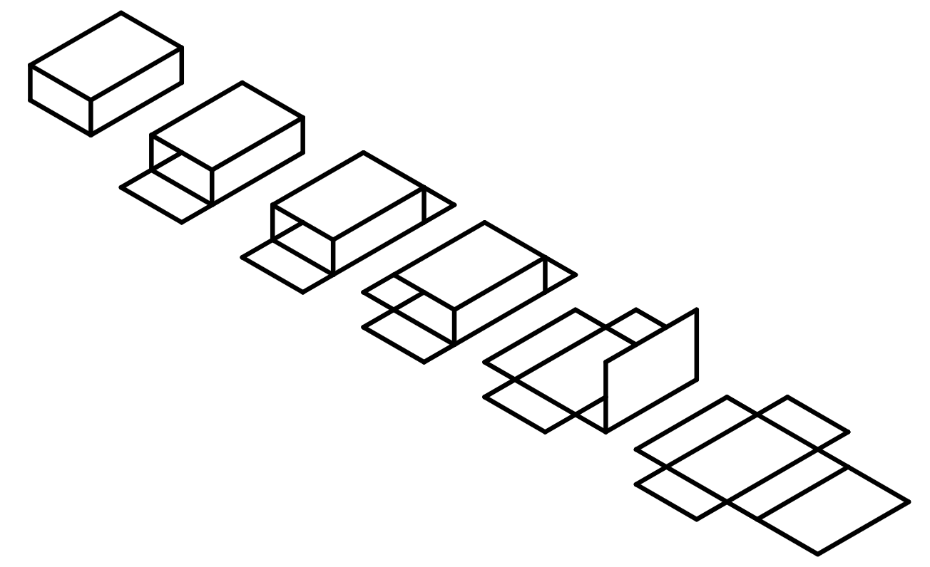
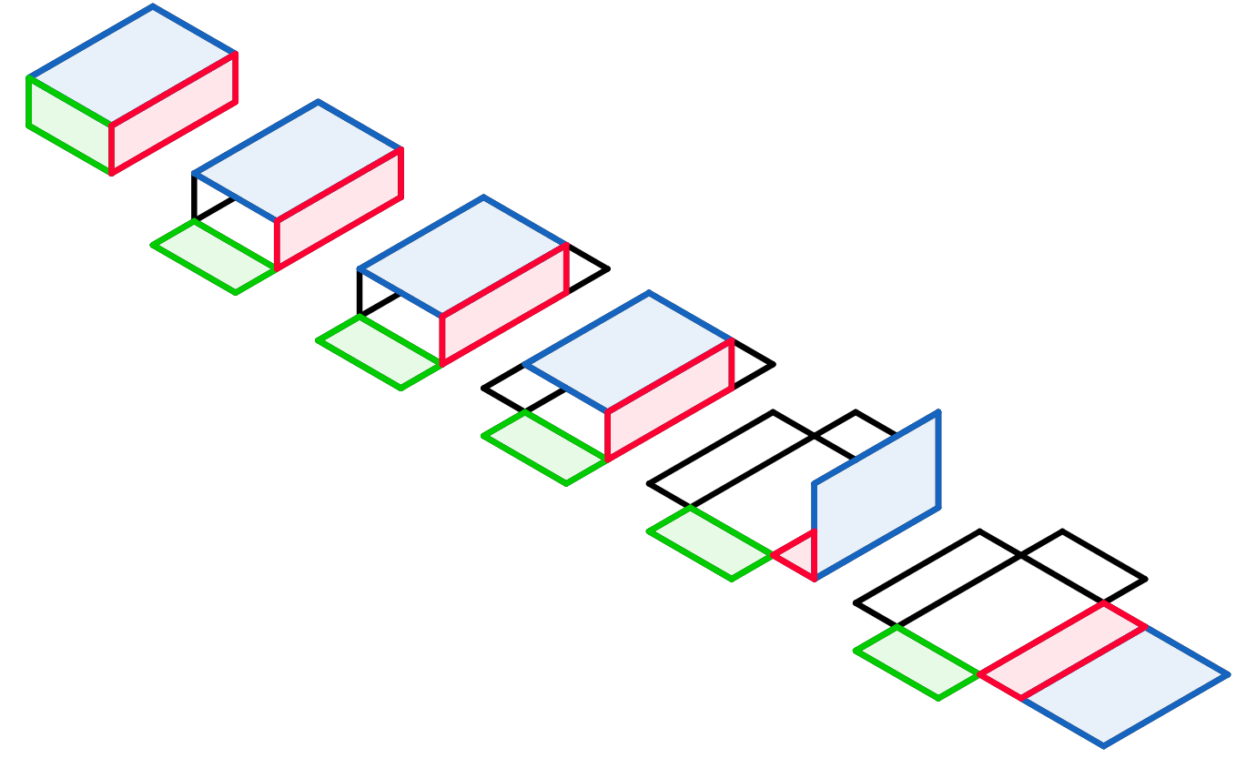
Nets of right prisms

Slide 8
Nets of right prisms
When we look at the 3D solid, we can count the number of faces and state what 2D shape they are.
Cuboid
A
6 faces in total
all the faces are rectangles
there are three pairs of rectangles
C
B
C
B
A
C
A
B
The shape of the net is created from the faces.

Slide 9

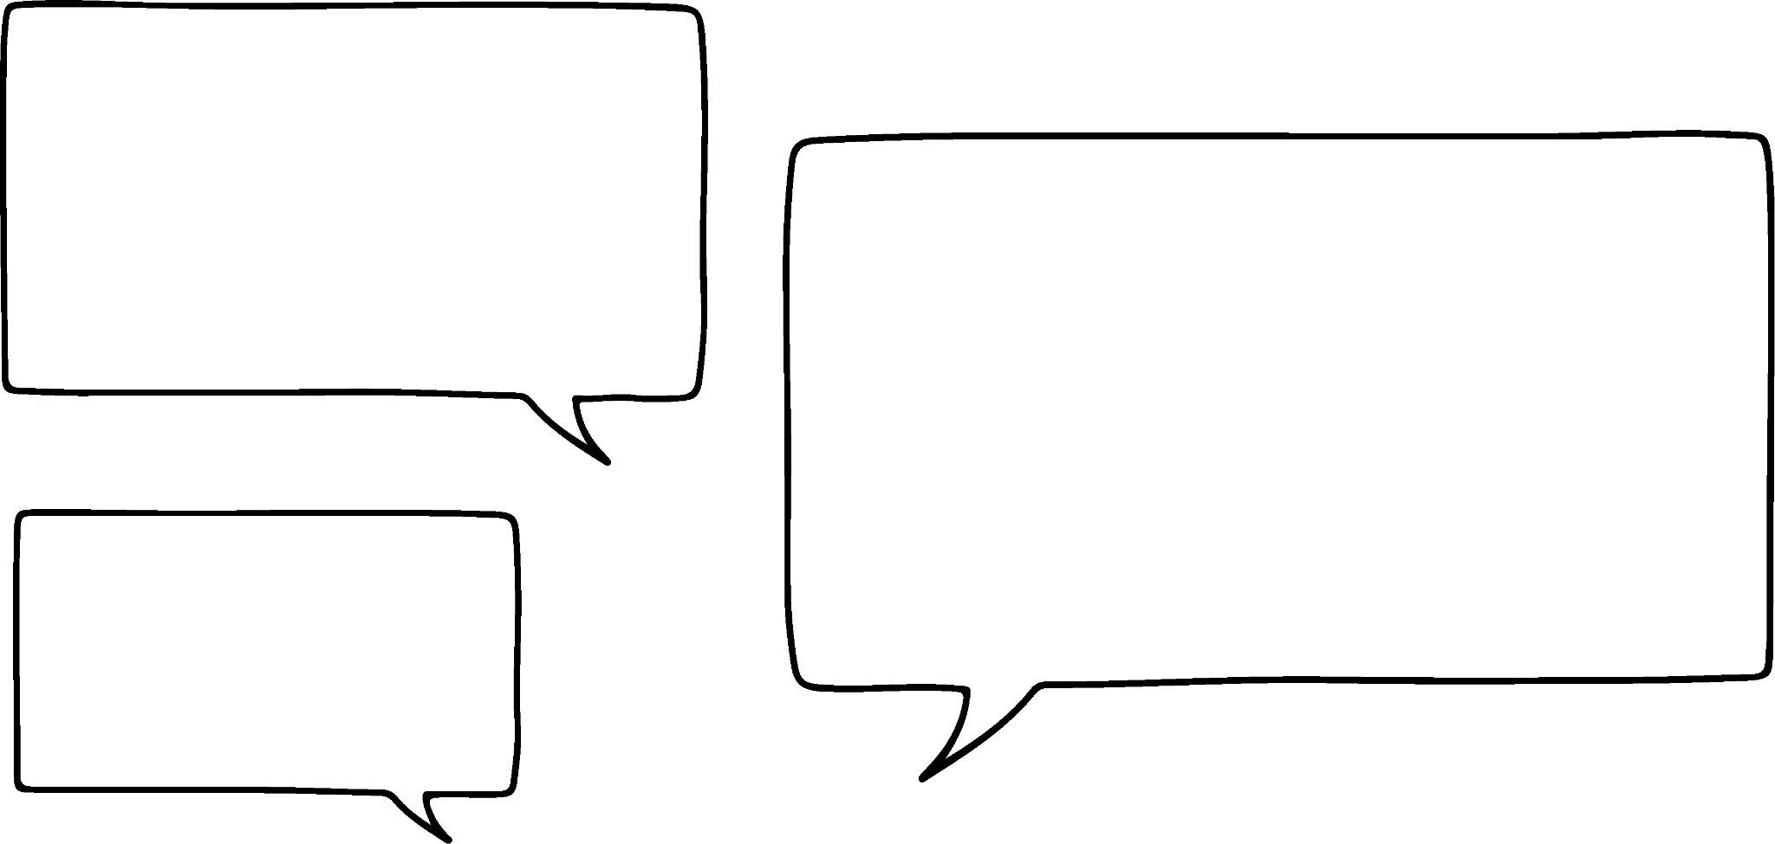


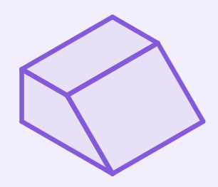


Nets of right prisms
Izzy is describing the net of a solid. Which solid is she describing?
The net is made of 5 faces.
a
b
c

Slide 10

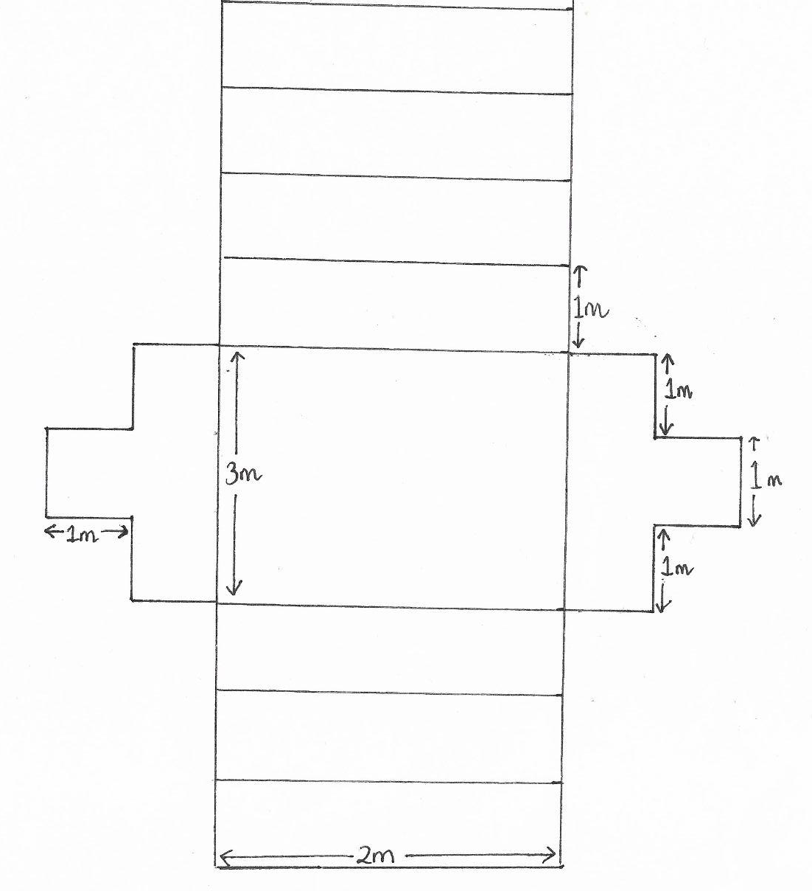
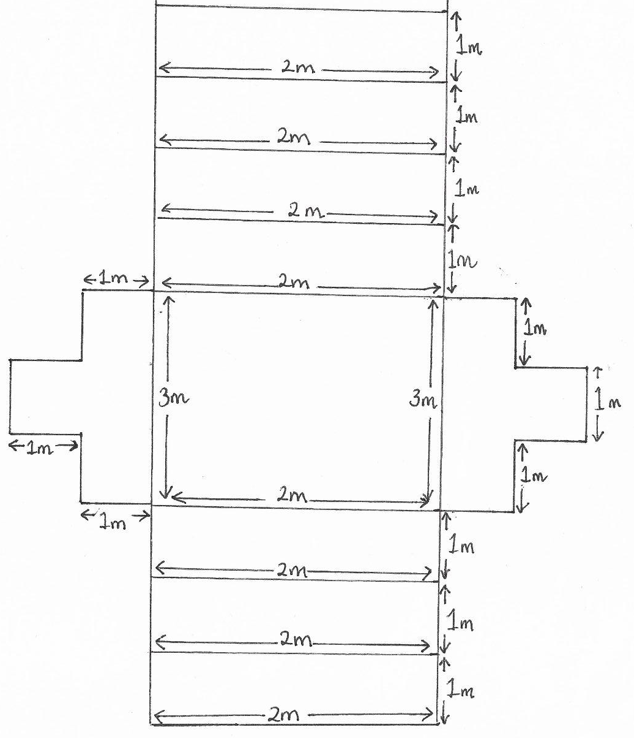
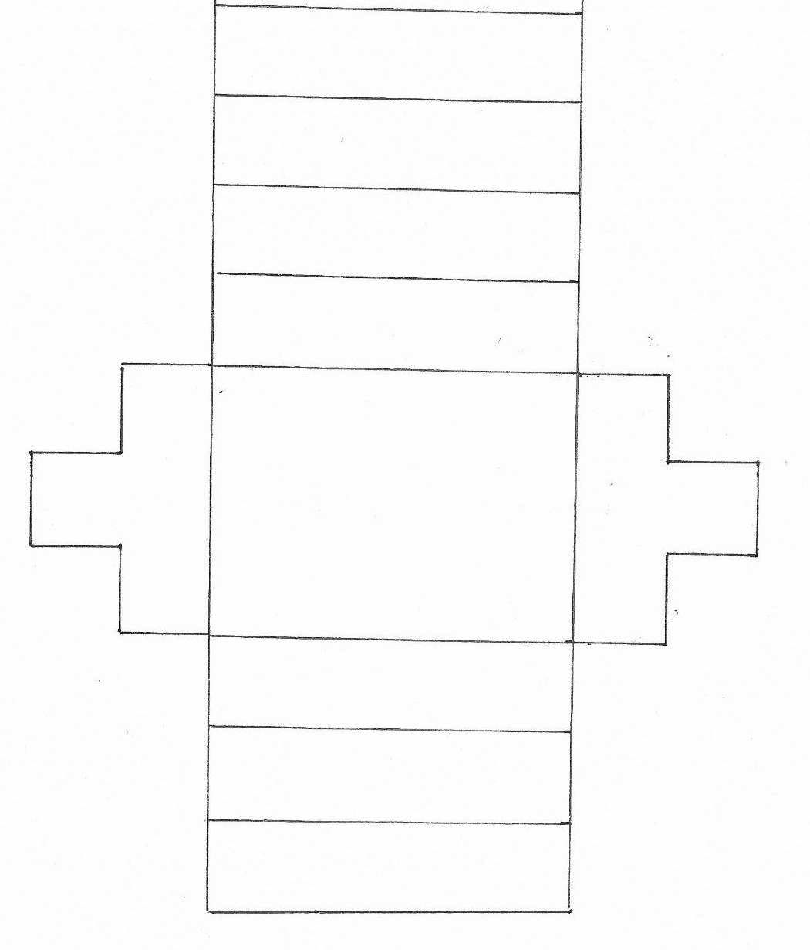
Nets of right prisms
A sketch of the net needs to convey the important information. It doesn’t need to be to scale.
Which of these sketches is the best?
c
b
a
a
b
c
1 m
1 m
3 m
1 m
2 m
1 m
b: it has just enough information on it

Slide 11
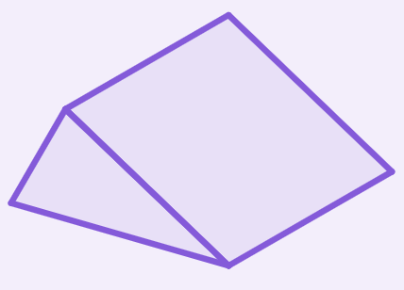
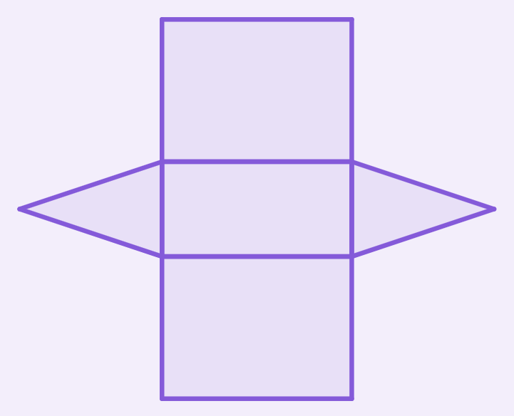
Nets of right prisms
Add the dimensions to the net of this right triangular prism.
4 cm
3.5 cm
3.5 cm
1.5 cm
4 cm
1.5 cm
3.5 cm
3.5 cm

Slide 12
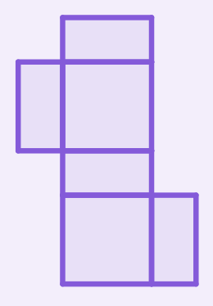
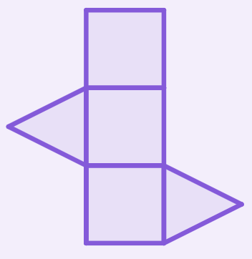
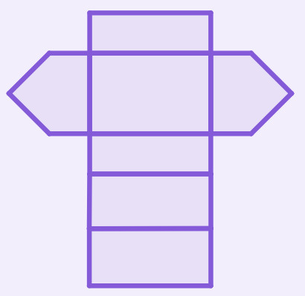
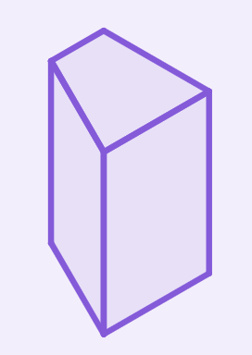
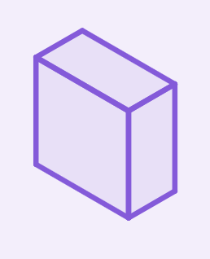
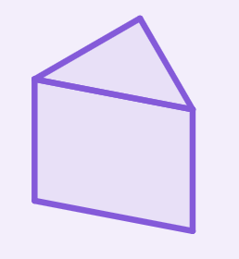
Nets of right prisms
1) Match the net to its prism. Sketch the missing net and prism.

Slide 13
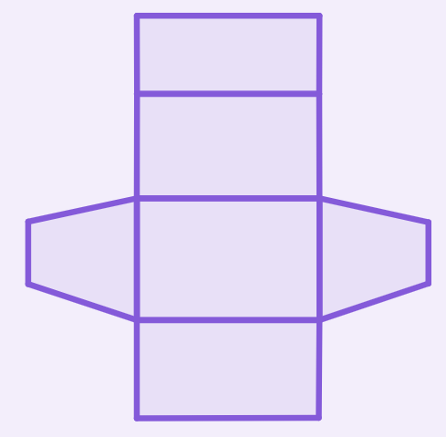
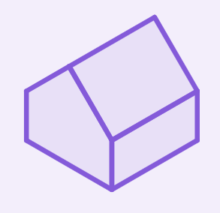
Nets of right prisms
1) Match the net to its prism. Sketch the missing net and prism.
e.g.
e.g.

Slide 14
Surface area of prisms
Nets of right prisms
Calculating the surface area of prisms
Being efficient in finding the surface area

Slide 15
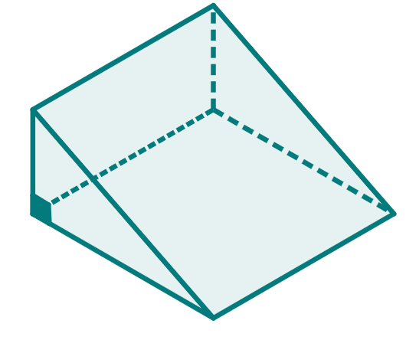
Calculating the surface area of prisms
The surface area is the total of all the faces’ areas.
The net is a compound shape made up of the faces of the solid.
⇒ Nets can help to find the surface area of prisms (and other 3D shapes).
This triangular prism has 5 faces:
2 congruent right-angled scalene triangles
3 different rectangles
5 cm
3 cm
4 cm
4.5 cm

Slide 16
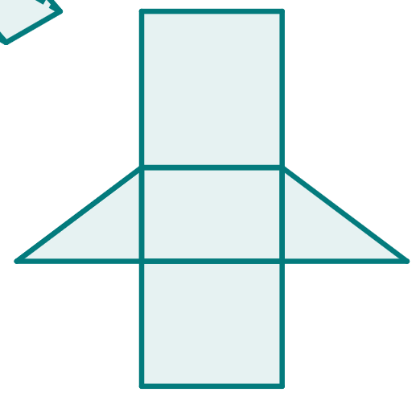
Calculating the surface area of prisms
The surface area is the total of all the faces’ areas.
The net is a compound shape made up of the faces of the solid.
⇒ Nets can help to find the surface area of prisms (and other 3D shapes).
Its net could look like this:
5 cm
5 cm
3 cm
3 cm
4 cm
4 cm
4.5 cm
4.5 cm

Slide 17
Calculating the surface area of prisms
First we will find the area of each face.
A: 5 ✕ 4.5 = 22.5 cm²
B: 3 ✕ 4.5 = 13.5 cm²
5 cm
A
C: 4 ✕ 4.5 = 18 cm²
B
D: (3 ✕ 4) ÷ 2 = 6 cm²
D
3 cm
D
D: (3 ✕ 4) ÷ 2 = 6 cm²
4 cm
C
Then we will sum the areas to find the surface area.
4.5 cm
Surface area = 22.5 + 13.5 + 18 + 6 + 6
= 66 cm²

Slide 18

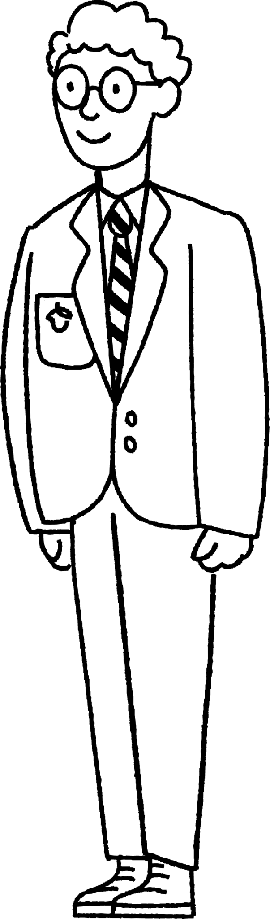

Calculating the surface area of prisms
Nets are made up of the faces from the solid. The surface area is not reliant on the arrangement of the faces, only the total area.
Just the polygons that are involved.
This means you do not have to draw a net every time.
Being careful not to miss any!
Lucas
Laura
Alex

Slide 19
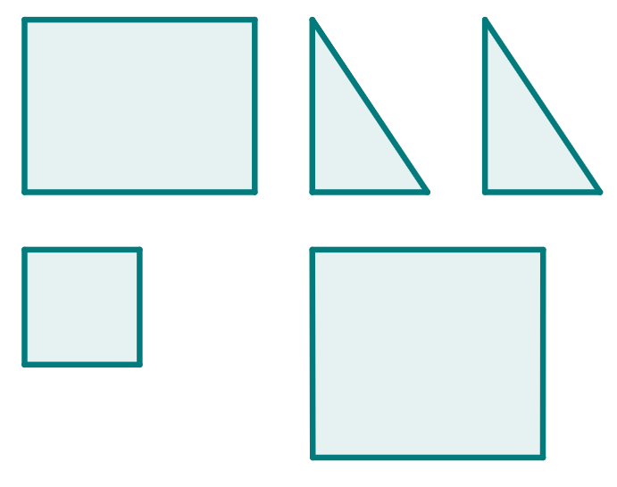
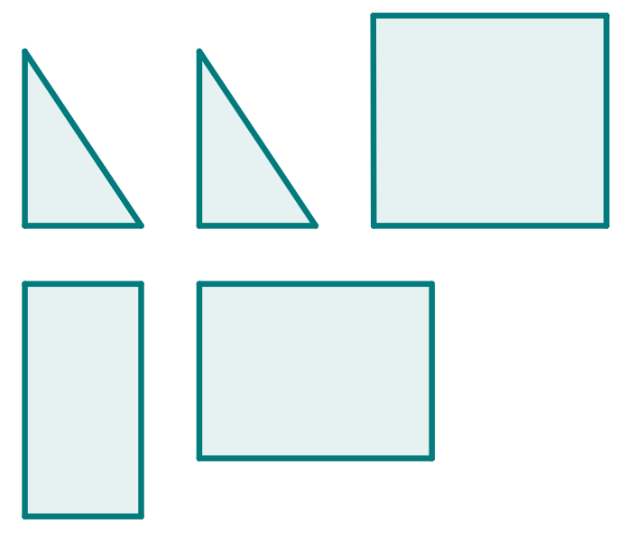

Calculating the surface area of prisms
Which of these could be the faces of a triangular prism?
All the rectangles should be the same length.
The two triangles should be congruent.

Slide 20

Calculating the surface area of prisms
1) a) Complete the description of the faces for this right octagonal prism.
irregular octagons 8
b) Draw all the unique faces of this prism, with dimensions.

Slide 21
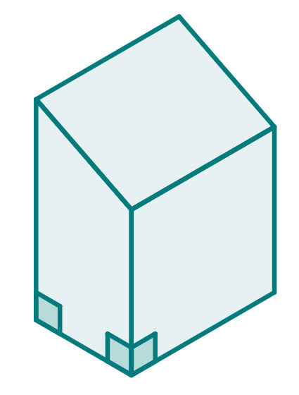
Calculating the surface area of prisms
2) Work out the surface area of this right trapezium prism.
3 cm
2.6 cm
3 cm
4 cm
2 cm

Slide 22

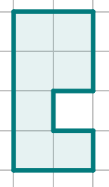
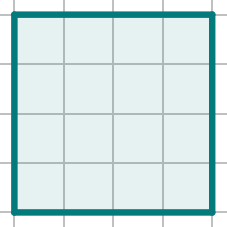

Calculating the surface area of prisms
1) a) Complete the description of the faces for this right octagonal prism.
irregular octagons 8
b) Draw all the unique faces of this prism, with dimensions.
2
rectangles
2
4
4 ✕
1
2 ✕
1 ✕
2
4
4
4
1
1
3 ✕
2
2
4

Slide 23
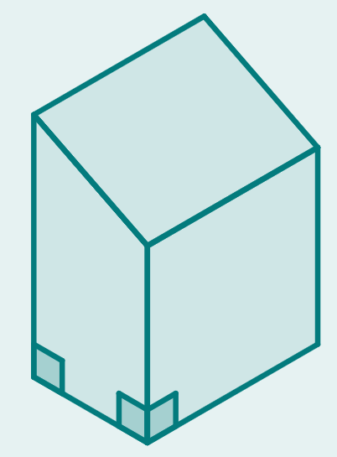

Calculating the surface area of prisms
2) Work out the surface area of this right trapezium prism.
2 ✕ area of each trapezium
= 2 ✕ ( ✕ (4 + 3) ✕ 2) = 14 cm²
rectangle 1 = 2 ✕ 3 = 6 cm²
rectangle 2 = 3 ✕ 3 = 9 cm²
rectangle 3 = 3 ✕ 2.6 = 7.8 cm²
rectangle 4 = 3 ✕ 4 = 12 cm²
Surface area
= 14 + 6 + 9 + 7.8 + 12 = 48.8 cm²
3 cm
2.6 cm
3 cm
4 cm
2 cm

Slide 24
Surface area of prisms
Nets of right prisms
Calculating the surface area of prisms
Being efficient in finding the surface area

Slide 25

Being efficient in finding the surface area
What can you tell about the faces of a right prism with this base?
It has two identical rectangular faces.
It has four additional faces that are rectangles.
Each rectangle will have the same perpendicular height. There will be two pairs of identical rectangles.
rectangle

Slide 26
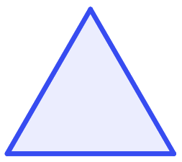
Being efficient in finding the surface area
What can you tell about the faces of a right prism with this base?
It has two identical equilateral triangular faces.
It has three faces that are rectangles.
Each rectangle has the same perpendicular height and the same width…
equilateral triangle
…so all three rectangles will have the same area.
Considering the properties can make finding the surface area more efficient.

Slide 27
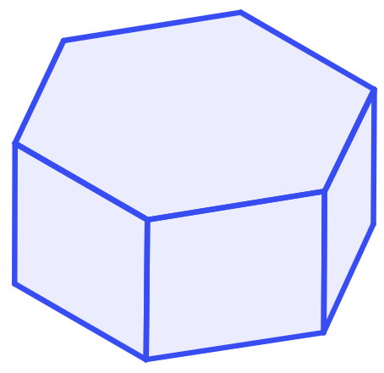


Being efficient in finding the surface area
Here is a right regular hexagonal prism.
Jun and Andeep both calculate the surface area.
Area = 210 cm²
7 cm
Surface area = 2 ✕ + 6 ✕
= 2 ✕ 210 + 6 ✕ (7 ✕ 9) = 420 + 378
= 798 cm²
9 cm
Surface area = + + + + + + +
= 210 + 7 ✕ 9 + 7 ✕ 9 + 7 ✕ 9 + 7 ✕ 9 + 7 ✕ 9 + 7 ✕ 9 + 210
= 210 + 63 + 63 + 63 + 63 + 63 + 63 + 210
= 798 cm²
Jun’s as it made use of the regularity of the hexagon.
Whose method is the most efficient?

Slide 28
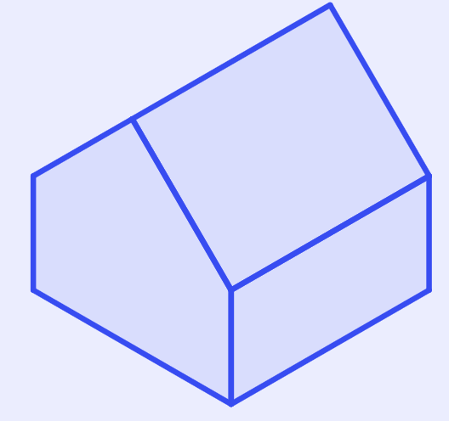
Being efficient in finding the surface area
Complete the method for the surface area of this right pentagonal prism.
Surface area
= 2 ✕ (5 ✕ 16 + ✕ 6 ✕ )
+ 16 ✕
+ 2 ✕ ( ✕ 12)
+ ✕ (10 ✕ 12)
= 256 + 192 + 120 + 240
= cm²
10 cm
10 cm
16
5 cm
11
cm
5 cm
12
5
2
16 cm
12 cm
808

Slide 29
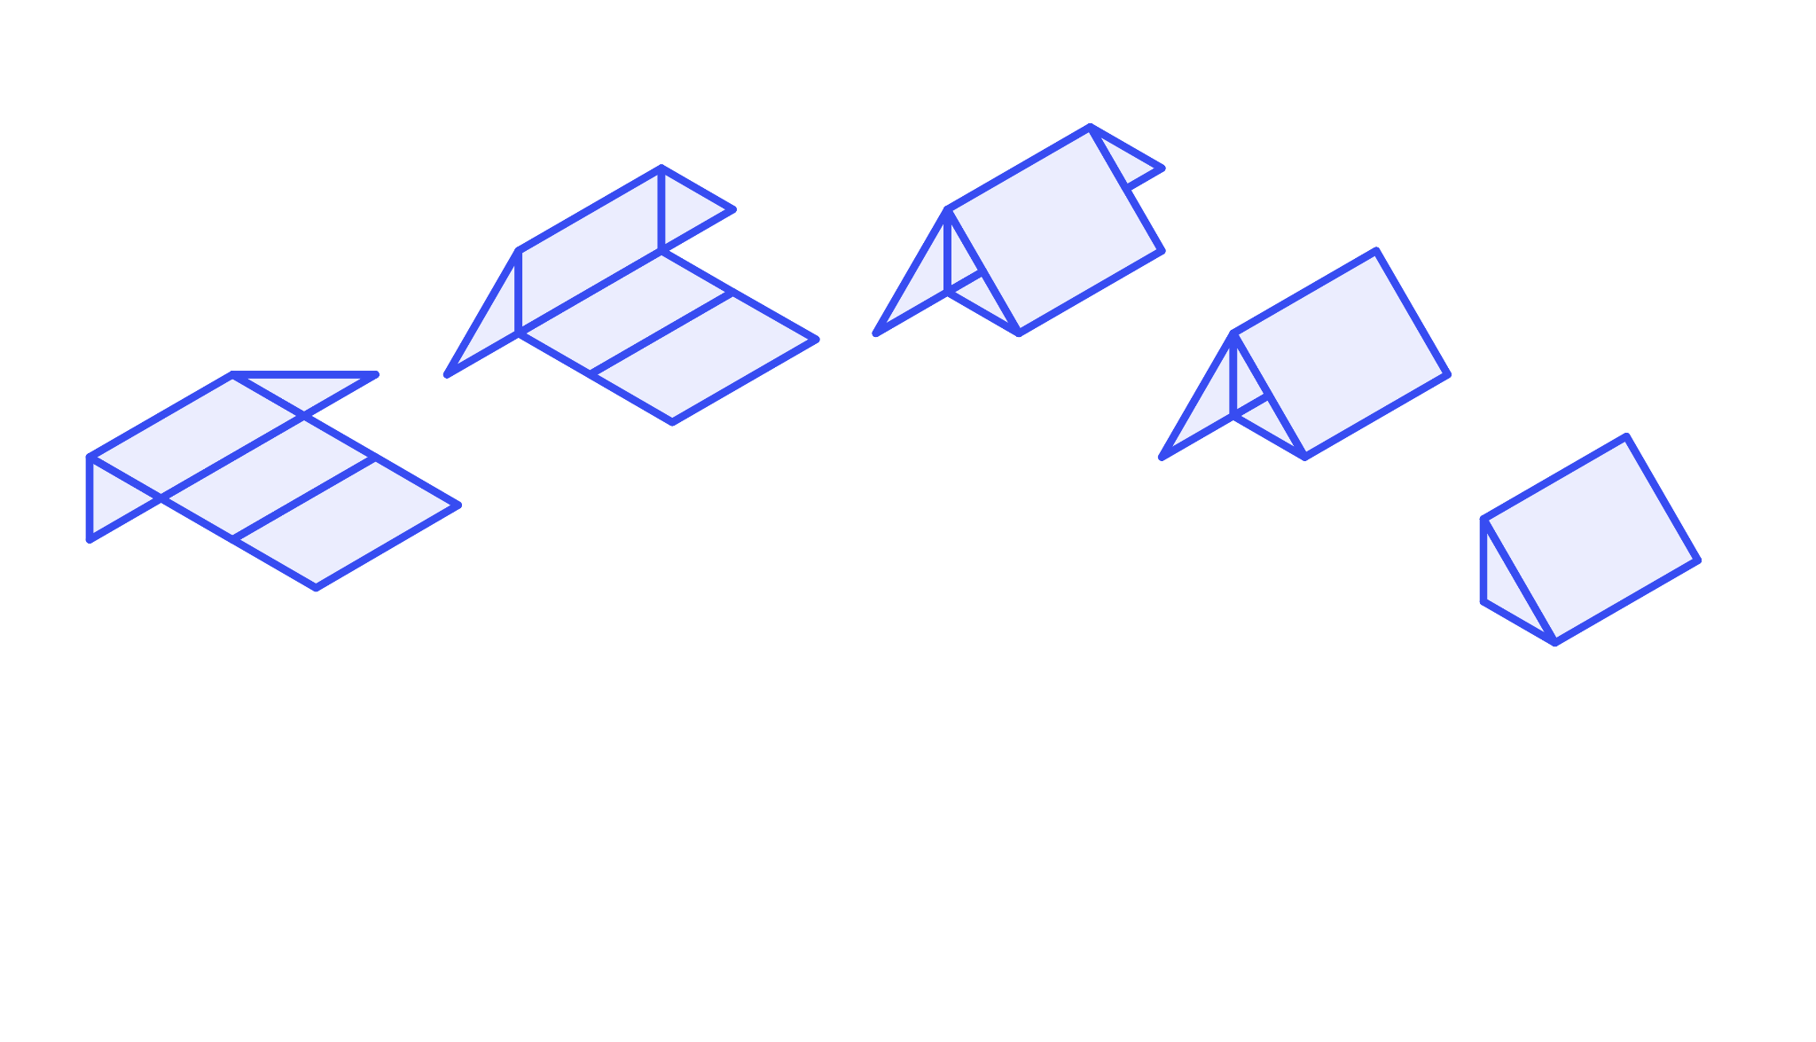
Being efficient in finding the surface area
The rectangular faces create a ‘tube’, when the net is folded. This is the case for all right prisms.

Slide 30
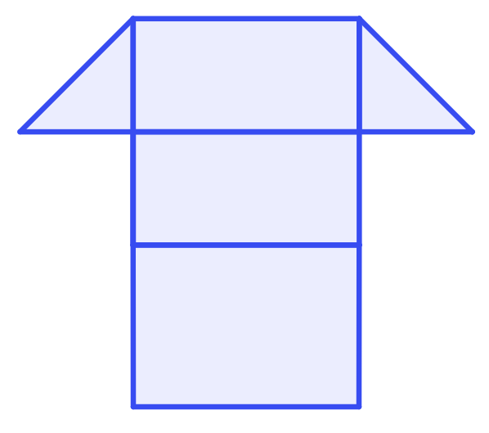
Being efficient in finding the surface area
The surface area of this triangular prism can be calculated by finding the area of each face and totalling.
Two triangular faces = 2 ✕ ( ✕ 4 ✕ 4)
= 16 cm²
4 cm
Three rectangular faces
= (4 ✕ 8) + (4 ✕ 8) + (5.7 ✕ 8)
= 109.6 cm²
4 cm
5.7 cm
Surface area
= 16 + 109.6
= 125.6 cm²
8 cm

Slide 31
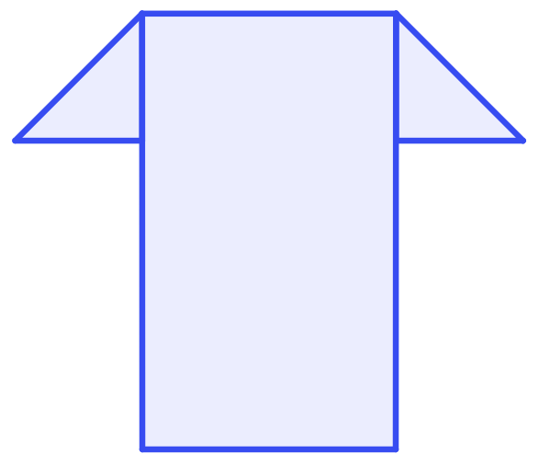
Being efficient in finding the surface area
The surface area of this triangular prism can be calculated by finding the area of each face and totalling.
Two triangular faces = 2 ✕ ( ✕ 4 ✕ 4)
= 16 cm²
4 cm
Three rectangular faces
→ one rectangle
4 cm
= (4 ✕ 8) + (4 ✕ 8) + (5.7 ✕ 8)
= 109.6 cm²
= 8 ✕ (4 + 4 + 5.7)
= 109.6 cm²
5.7 cm
Surface area
= 16 + 109.6
= 125.6 cm²
8 cm

Slide 32
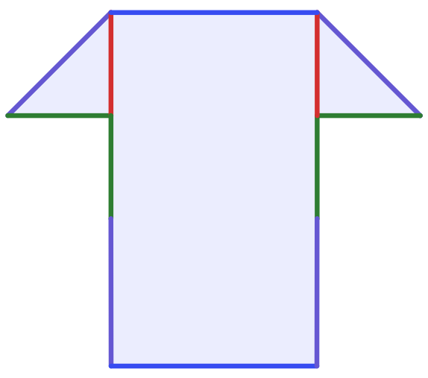

Being efficient in finding the surface area
The surface area of this triangular prism can be calculated by finding the area of each face and totalling.
Two triangular faces = 2 ✕ ( ✕ 4 ✕ 4)
= 16 cm²
4 cm
Three rectangular faces → one rectangle
= 8 ✕ (4 + 4 + 5.7)
= 109.6 cm²
4 cm
(4 + 4 + 5.7) this is the perimeter of the triangle
5.7 cm
Surface area
= 16 + 109.6
= 125.6 cm²
8 cm
Sofia

Slide 33
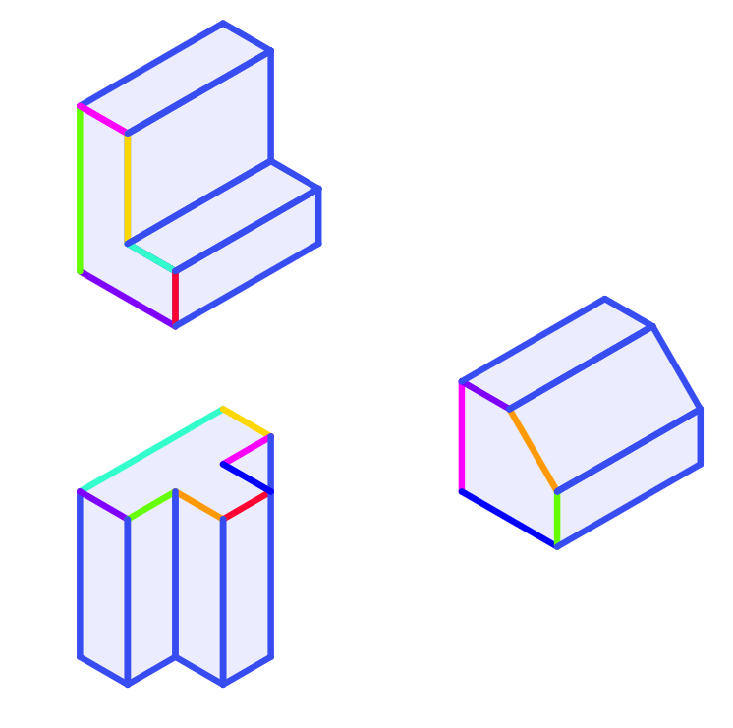
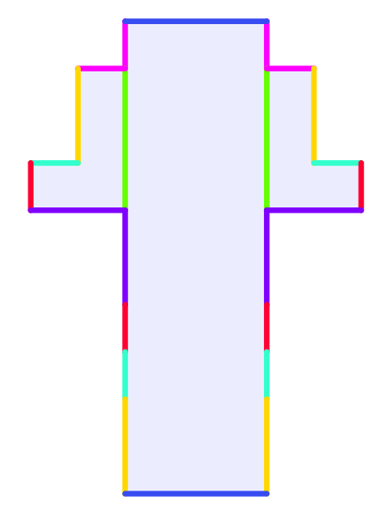
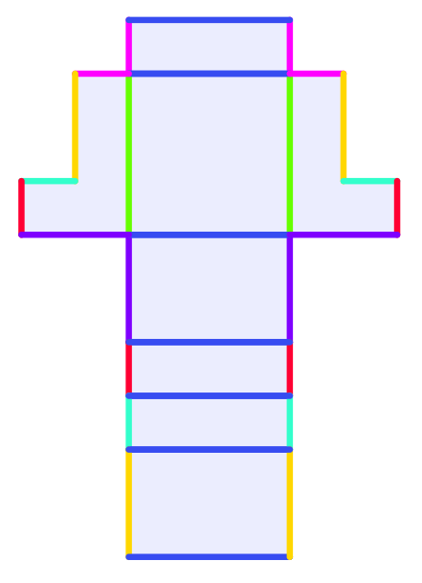
Being efficient in finding the surface area
This is the same for all right prisms. The perimeter of the cross-sectional face is the length of all the rectangular faces combined as one.
perimeter

Slide 34
Being efficient in finding the surface area
Find the surface area of this right equilateral triangular prism using the following three methods:
1) find the area of each face then sum
2) find the area of each unique face then sum multiples of those.
3) use the perimeter of the shape to help find the area of all the rectangular faces and add the area of the two triangles.
5 cm
3.5 cm
4 cm
Prism length 5 cm
Triangle:
perpendicular height 3.5 cm
edge lengths 4 cm

Slide 35
Being efficient in finding the surface area
Method 1: Total all the areas
3.5 cm
3.5 cm
5 cm
5 cm
5 cm
4 cm
4 cm
4 cm
4 cm
4 cm
Area
= × 4 × 3.5
= 7
Area
= × 4 × 3.5
= 7
Area
= 4 × 5
= 20
Area
= 4 × 5
= 20
Area
= 4 × 5
= 20
Surface area = 7 + 7 + 20 + 20 + 20 = 74 cm²

Slide 36
Being efficient in finding the surface area
Method 2: Use congruent faces to be more efficient
3.5 cm
3.5 cm
5 cm
5 cm
5 cm
4 cm
4 cm
4 cm
4 cm
4 cm
Area
= 2 × ( × 4 × 3.5)
= 14
Area
= 3 × (4 × 5)
= 60
Surface area = 14 + 60 = 74 cm²

Slide 37
Being efficient in finding the surface area
Method 3: Use one rectangular face and two congruent faces
3.5 cm
3.5 cm
5 cm
4 cm
4 cm
12 cm
Area
= 2 × ( × 4 × 3.5)
= 14
Area
= 12 × 5
= 60
Surface area = 14 + 60 = 74 cm²

Slide 38
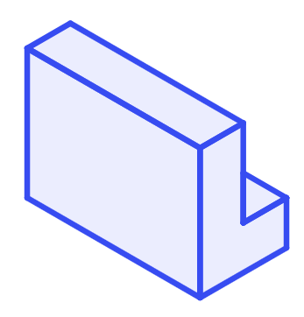
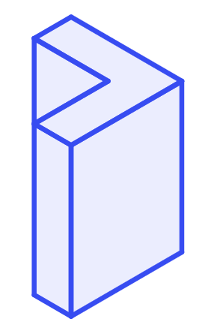
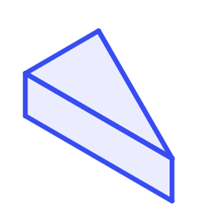
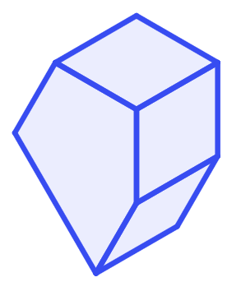
Being efficient in finding the surface area
Calculate the surface area of the following right prisms:
Diagrams not drawn to scale
1 m
9 mm
1)
12 m
2)
6 mm
3 m
12 mm
1 m
2 m
9 mm
3 mm
2 m
3)
10 cm
4)
12 cm
2 m
4 cm
2 m
45 m²
4 m
2.5 m
13 cm
2 m

Slide 39
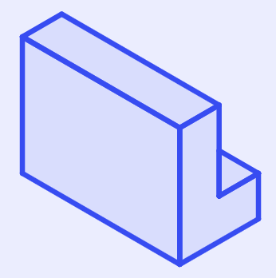
Being efficient in finding the surface area
1) Calculate the surface area of the following right prisms
Diagrams not drawn to scale
1 m
1 m
12 m
2 × Area of L shape
= 2 × ((3 × 2) - (2 × 1))
= 2 × 4 = 8 m²
2 m
3 m
3 m
1 m
1 m
1 m
2 m
2 m
Perimeter of L shape
12 × perimeter of L shape
= 12 × (3 + 1 + 2 + 1 + 1 + 2)
= 12 × 10 = 120 m²
12 m
Surface area = 128 m²

Slide 40
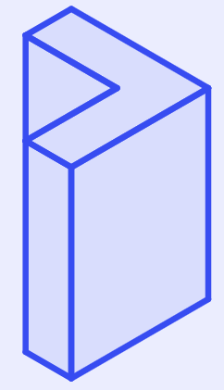
Being efficient in finding the surface area
2) Calculate the surface area of the following right prisms
Diagrams not drawn to scale
3 mm
9 mm
6
mm
2 × Area of L shape
= 2 × ((9 × 9) - (6 × 6))
= 2 × 45 = 90 mm²
6 mm
6 mm
9 mm
12 mm
3 mm
9 mm
9 mm
3 mm
Perimeter of L shape
12 × perimeter of L shape
= 12 × (9 + 3 + 6 + 6 + 3 + 9)
= 12 × 36 = 432 mm²
12 mm
Surface area = 522 mm²

Slide 41
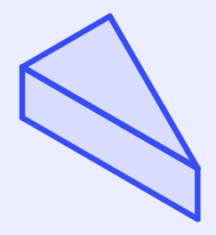
Being efficient in finding the surface area
3) Calculate the surface area of the following right prisms
Diagrams not drawn to scale
10 cm
2 × Area of triangle
= 2 × ( × 10 × 12)
= 120 cm²
12 cm
13 cm
4 cm
12 cm
10 cm
13
cm
4 × perimeter of triangle
= 4 × (13 + 10 + 13)
= 4 × 36 = 144 cm²
Perimeter of triangle
4 cm
Surface area = 264 cm²

Slide 42
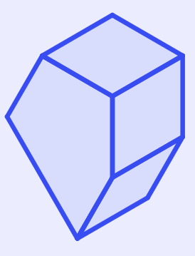
Being efficient in finding the surface area
4) Calculate the surface area of the following right prisms
Diagrams not drawn to scale
2 m
2 × Area of pentagon
= 2 × 45
= 90 m²
2 m
2 m
45 m²
4 m
2.5 m
2 m
2 × perimeter of pentagon
= 2 × (2 + 4 + 2.5 + 2 + 2)
= 2 × 12.5 = 25 m²
Perimeter of pentagon
2 m
Surface area = 115 m²

Slide 43
Surface area of prisms
The surface area of a prism is the sum of the area of all faces.
The net of a prism can be helpful to find the surface area of the prism.
To be more efficient try to use the properties of the shape to find congruent faces.
The best method to use is the one you understand best and can apply reliably to different prisms.

Slide 44

© Oak National Academy 2023.
Produced in partnership with Mathematics in Education and Industry.
Licensed on the Open Government Licence v3.0, except where otherwise stated. See Oak terms and conditions.

